Slide 1


International Conference on
Emerging Techniques in Computational Intelligence
21–23 August 2025
Iron Shield Real Time Defense System Using Neural Network
Shreevarsinii Balasekar , Sanjay R , Dr. S. Manimaran
1 Student of Artificial Intelligence Amrita Vishwa Vidyapeetham Coimbatore, India
2 Assistant Professor ( Sr. Gr.) School of Artificial Intelligence Amrita Vishwa Vidyapeetham Coimbatore, India

Slide 2
Introduction:
Modern defense needs real-time intelligent systems for tasks like missile interception.
Traditional rule-based methods work but struggle with fast-changing threats.
AI/ML can detect real threats, but many models are too slow for real-time use.
Solution: a lightweight feedforward neural network trained on simulated missile trajectories.
Optimized with Keras Tuner (99% accuracy) and refined using F1-score thresholding.
Deployed as a TensorFlow Lite model for fast use on edge devices.
A physics-based safety check is added to reduce false alarms.
Final system is accurate, fast, and practical for real-world defense.
.
ICETCI 2025
2

Slide 3
Literature review
Paper Title | Author(s) | Year | Key Methodology
Dome of Delusion: The Many Costs of Ballistic Missile Defense [1] | Igor Moric et al. | 2025 | Critical analysis of cost-effectiveness and challenges in missile defense systems like Iron Dome
The Golden Dome Delusion: Prioritizing Missiles Over Humanity [2] | Irshad Ahmad et al. | 2025 | Examination of missile defense prioritization and humanitarian concerns
Safe Cooperative Guidance for Multi-Missile Systems [3] | Jianglong Yu et al. | 2021 | Leader-follower guidance with artificial potential field + backstepping control.
ICETCI 2025
4

Slide 4
Literature review
Paper Title | Author(s) | Year | Key Methodology
Secure Cooperative Guidance Policy for Multi-Missile Platforms [4] | Jianglong Yu et al. | 2020 | Time-to-go synchronization, multi-missile coordination, robust under cyber-attacks.
Intercept Point Prediction of Ballistic Missile Defense Using Neural Network Learning [5] | Jun-Yong Lee et al. | 2020 | Neural network predicts intercept point (PIP) & launch time; reduces computation time.
A Novel Aircraft and Missile Accurate Positioning and Tracking System using Global Satellite Networks [6] | Hayder Chyad et al. | 2021 | High-precision real-time positioning & tracking via satellite communications.
ICETCI 2025
3

Slide 5
Dataset Information
A synthetic dataset was generated to simulate missile trajectories.
Two classes: Intercept (1) and Ignore (0), with a balanced 50:50 split.
Total dataset size: 20,000 samples.
Each sample has 6 input features: initial position (x₀, y₀, z₀ in km) and initial velocity (vx, vy, vz in km/s).
Trajectories modeled with gravity (g = 0.0098 km/s²) and Gaussian noise (σ = 0.1–0.5 km).
Position equations:
x(t) = x₀ + vx·t + noise
y(t) = y₀ + vy·t + noise
z(t) = z₀ + vz·t – ½·g·t² + noise
This dataset provides a realistic yet controlled environment for training the model.

Slide 6
Dataset Information
Trajectories within 10 km defense zone → Intercept (1), else Ignore (0).
Dataset balanced to prevent bias.
Features scaled before training.
Data split: 70% train, 20% validation, 10% test.
Physics-based dataset ensures reliable training.
Future work: testing with real missile data (DRDO).

Slide 7
Proposed Work
Goal: Classify missiles → Intercept (threat) or Ignore (non-threat)
Dataset:
20k synthetic trajectories (6 features: position + velocity)
Physics-based, balanced labels (R = 10 km defense zone)
Preprocessing: Normalized (StandardScaler), randomized, split (70/20/10)
Model: Feedforward NN → layers, ReLU + Dropout, Sigmoid output
Optimization: Keras Tuner (learning rate & layer size), F1-optimized threshold (0.8946)
Deployment: TensorFlow Lite on edge devices + physics-based override check
Result: Fast, accurate, resource-efficient real-time defense system

Slide 8
Proposed Work
Insights
FNN gives the best performance for missile prediction.
Accuracy ≈ 99% with very fast inference (0.28 ms) → real-time ready.
Logistic Regression & SVM = decent results; Decision Tree = weakest.
Robustness tested by noise variation & feature removal.
System is accurate, fast, and reliable for defense use.

Slide 9
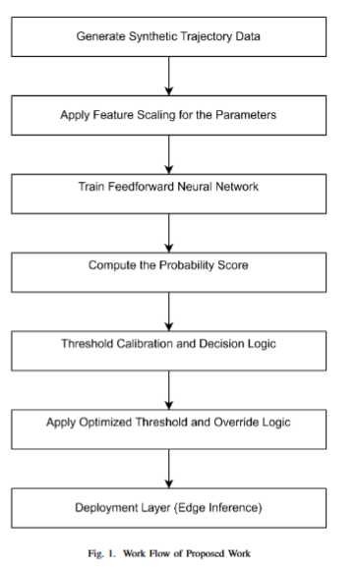

Slide 10
Results and Comparison
Noise Simulation: Added Gaussian noise to mimic real-world uncertainty.
Preprocessing: Normalized features using StandardScaler.
Training Setup: Adam optimizer (LR=0.001), batch size = 32, early stopping.
Model Tuning: Keras Tuner optimized hidden units & learning rate.
Final Model: 3 hidden layers (64, 32, 16), ReLU activations, 20% dropout.
Deployment: Converted to TensorFlow Lite for real-time use.
Reliability: Physics-based override check added.

Slide 11
Results (Performance Metrics)
Model | Accuracy | F1-Score
Random Forest | 88.6% | 0.89
SVM | 94.2% | 0.94
Logistic Regression | 97.5% | 0.97
Decision Tree | 86.2% | 0.86
FNN (Proposed) | 99.0% | 0.99
Model | Inference Time (ms)
Random Forest | 2.14
SVM | 3.50
Logistic Regression | 3.12
Decision Tree | 4.15
FNN (Proposed) | 0.28
Table 1. compares the performance of different models such as Random Forest, SVM, Logistic Regression, Decision Tree and FNN on the first dataset using raw input features.
Table 2. Represents the different model with the inference time

Slide 12
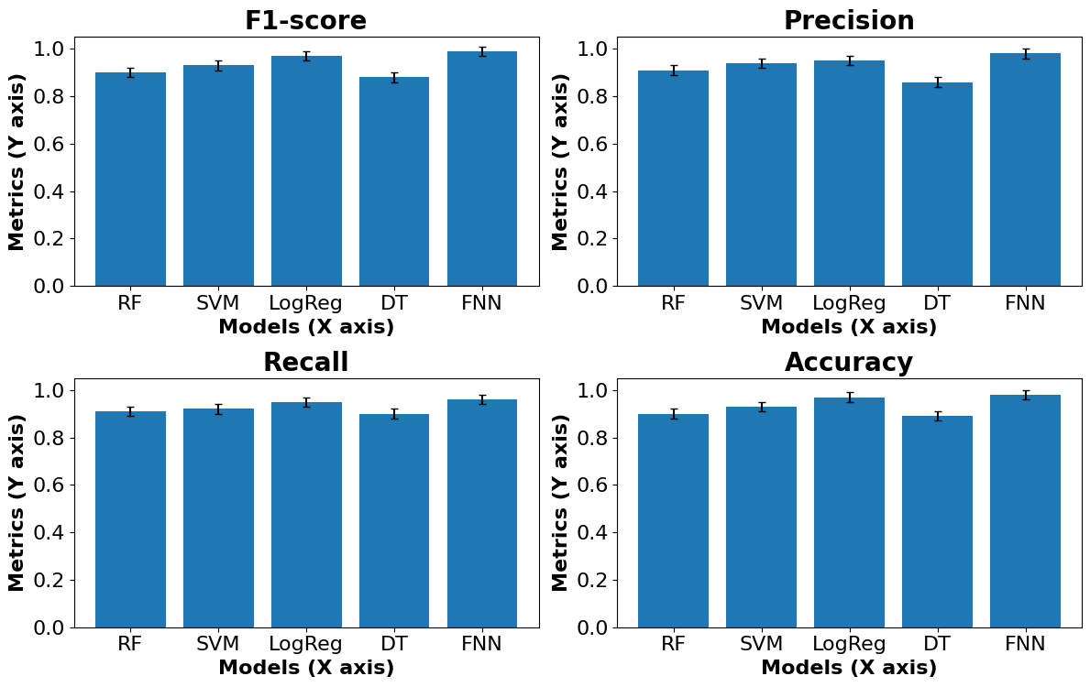

Slide 13
Conclusion and Future Works
High Accuracy: FNN achieved 99.49% accuracy
Real-Time Ready: Inference time 0.28 ms (well below 10 ms limit).
Optimized Model: Automated tuning (Keras Tuner), probability calibration (Platt scaling), and post-processing rule added.
Safe & Reliable: Physics-based override + CLI for easy user interaction and decision validation.
Strong Evaluation: Tested on unseen missile case → correctly classified as Ignore (12.225 km away).
Future Work: Extend to multi-target tracking, adversarial scenarios, and real-world battlefield integration.

Slide 14
References:
Moric, I., et al. (2025). Dome of Delusion: The Many Costs of Ballistic Missile Defense. [Journal/Conference name if available].
Ahmad, I., et al. (2025). The Golden Dome Delusion: Prioritizing Missiles Over Humanity. [Journal/Conference name if available].
Yu, J., et al. (2021). Safe Cooperative Guidance for Multi-Missile Systems. [Journal/Conference name].
Yu, J., et al. (2020). Secure Cooperative Guidance Policy for Multi-Missile Platforms. [Journal/Conference name].
Lee, J.-Y., et al. (2020). Intercept Point Prediction of Ballistic Missile Defense Using Neural Network Learning. [Journal/Conference name].
Chyad, H., et al. (2021). A Novel Aircraft and Missile Accurate Positioning and Tracking System using Global Satellite Networks. [Journal/Conference name].

